Slide 1

TINY C COMPILER (TCC)
Compiler Design Pipeline and Live Demonstration
Team Member | PRN
Mayur More | 245109052
Sakib Latkar | 245109054
Kushagra Jha | 245109069

Slide 2
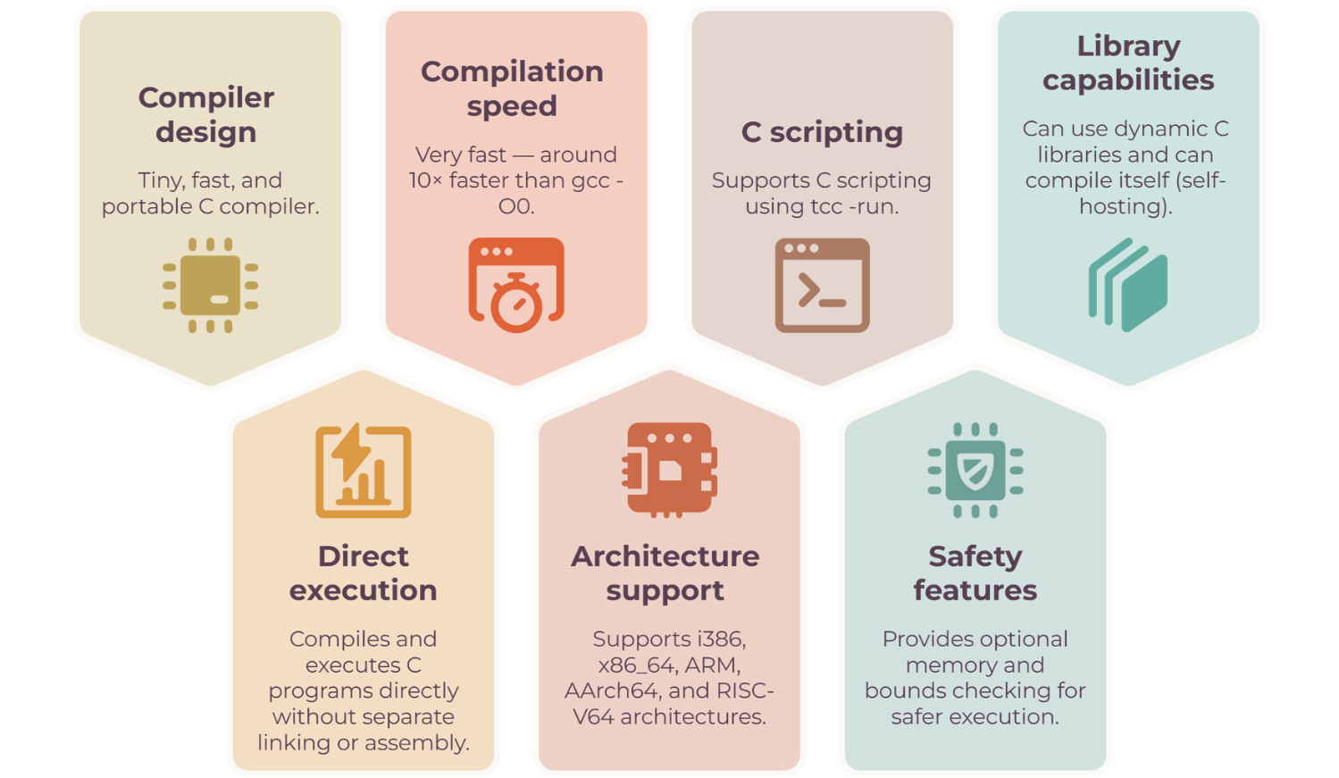
TCC: OVERVIEW AND FEATURES

Slide 3

















TCC COMPILATION WORKFLOW
Lexical analysis
Converts source code into tokens.
Syntax analysis
Checks tokens according to C grammar.
TCC
C Source Program
(source.c)
Tiny CCompiler
Checks for parsing and compilation logic
Semantic analysis
Intermediate Code Generation
Creates an internal form, an internal representation for code generation.
Compiler
Processing
Code Optimization
Improves the intermediate code for efficient execution.
Code Generation and Linking
Generates machine code, resolves symbols, and creates the .exe file.
.exe
Output

Slide 4
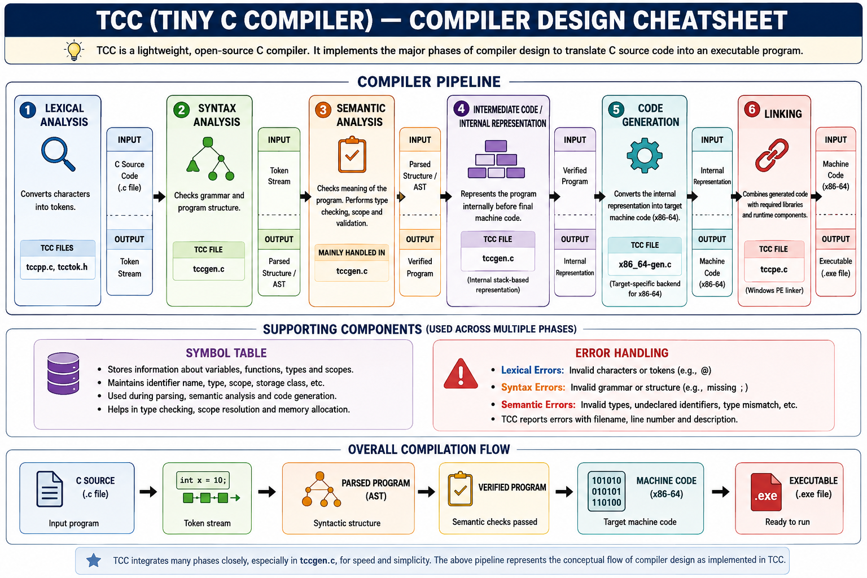

Slide 5

PRACTICAL DEMONSTRATION

